Slide 1
Analysis of Amazon Food Reviews
Team Members:
V T Vishwanath 2BV14IS114
Raghavendra P 2BV14IS131
Vijay Kumar 2BV14IS118
Surendar Singh 2BV14IS112

Slide 2
ABOUT
The dataset is taken from www.kaggle.org
The dataset is provided by the Amazon company and all the products are food items.
The dataset contains the details of the reviews about the products over time.
The dataset contains productId for which review details are given; and the same product can have reviews over time.

Slide 3
CONTENTS
Problem Statement
Objectives
Description of the Data
Dataset Statistics
Implementation and Analysis of data

Slide 4
PROBLEM STATEMENT
To analyse the review for each food item and provide the status of it in the market over time.

Slide 5
OBJECTIVES
Providing average sentiment for each product based on the text present in each review.
Taking most helpful review from each product.
Providing the details of the scores for each food item( Saying how many 1 star, 2 star reviews till 5 stars).
Providing the time series analysis for the product.

Slide 6
DESCRIPTION OF THE DATA
The Amazon Fine Food Reviews dataset consists of 568,454 food reviews Amazon users left up to October 2012.
Volume of the data – 289MB
Velocity – Amazon review dataset consists of real time reviews regarding food items by the users.
Data must be categorized based on the rating provided. Thus the retrieval of the data becomes faster as the data becomes organized.
Each day more than 5000 food items will be sold and this number increases gradually with increase in companies performance.

Slide 7
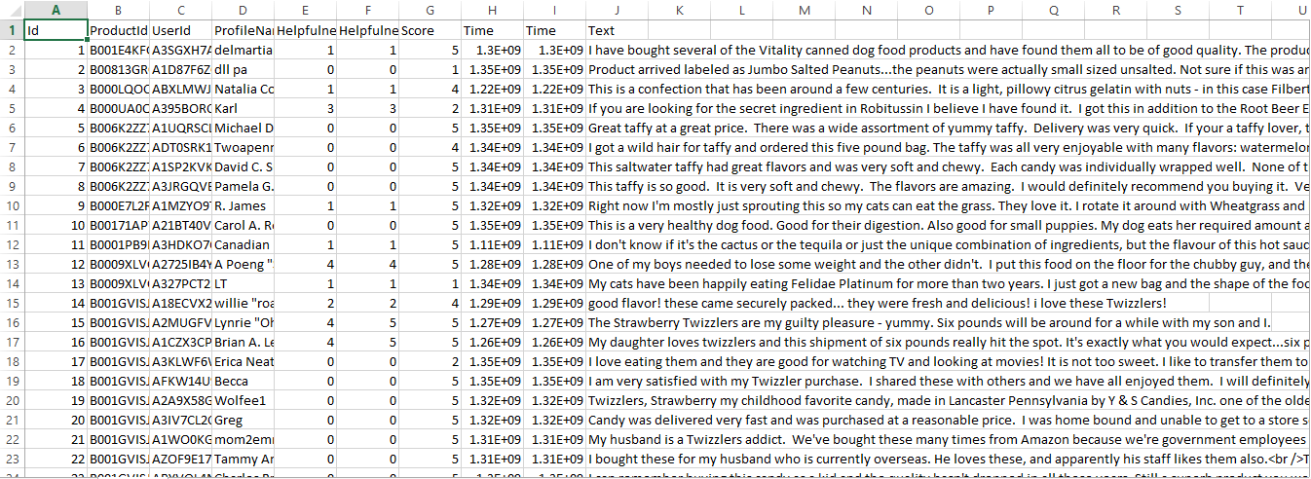
DATASET

Slide 8
DESCRIPTION OF THE DATA
The columns in the dataset are:
Id – column number
ProductId - unique identifier for the product
UserId - unique identifier for the user
Profile Name
Helpfulness Numerator - number of users who found the review helpful
Helpfulness Denominator - number of users who indicated whether they found the review helpful
Score - rating between 1 and 5
Time - timestamp for the review
Summary - brief summary of the review
Text - text of the review

Slide 9
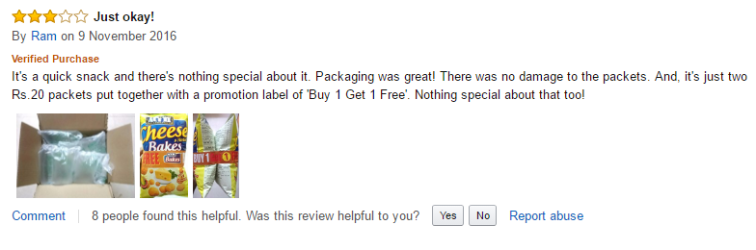

Slide 10
DATASET STATISTICS
Number of reviews | 568,454
Number of users | 256,059
Number of products | 74,258
Users with > 50 reviews | 260
Median no. of words per review | 56
Timespan | Oct 1999 - Oct 2012

Slide 11
IMPLEMENTATION AND ANALYSIS
Python script using pandas package is used for the implementation of the objectives
Providing average sentiment for each product based on the text present in each review:
“vaderSentiment” library is used for the sentimental analysis of the comments by the user.
Providing the time series analysis for the product based on the previous history.

Slide 12
IMPLEMENTATION AND ANALYSIS
Sentiment provides the information of each product saying how good or bad the product is based on the comments given by the users.
It signifies the company(Amazon) to improve the products which are not gaining appreciation from the users.

Slide 13
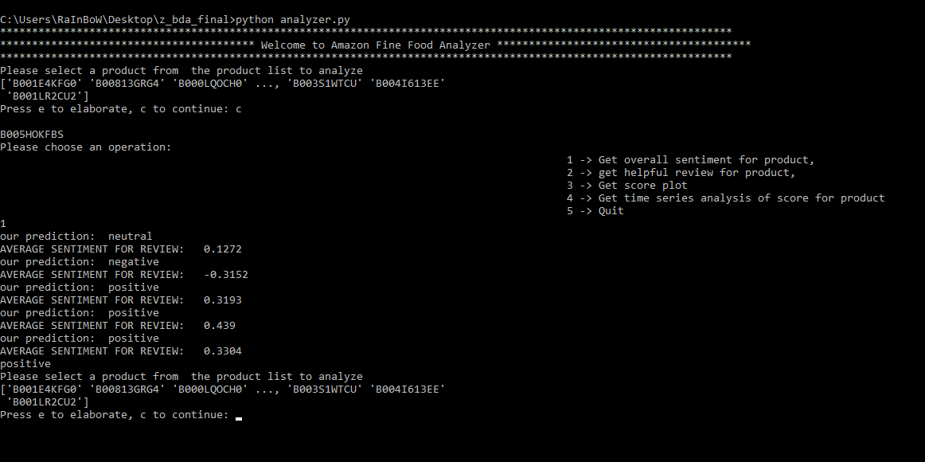
IMPLEMENTATION AND ANALYSIS

Slide 14
IMPLEMENTATION AND ANALYSIS
2. Taking most helpful review from each product:
Most helpful reviews for a particular product is done by considering Helpfulness Numerator and Denominator.
Helpfulness Numerator signifies that the review is most viewed by the user.
Helpfulness Denominator signifies that the comment for that review is found good.

Slide 15
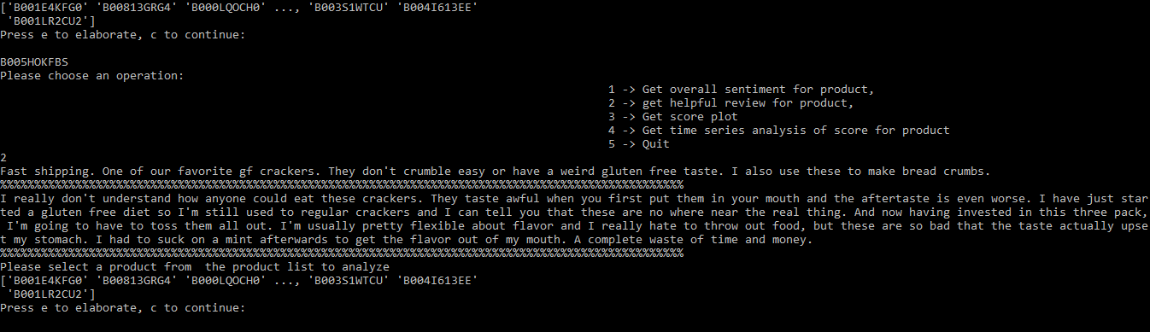
IMPLEMENTATION AND ANALYSIS

Slide 16
IMPLEMENTATION AND ANALYSIS
3. Providing the details of the scores for each food item( Saying how many 1 star, 2 star reviews till 5 stars):
This will show the reaction of users for a particular product.

Slide 17
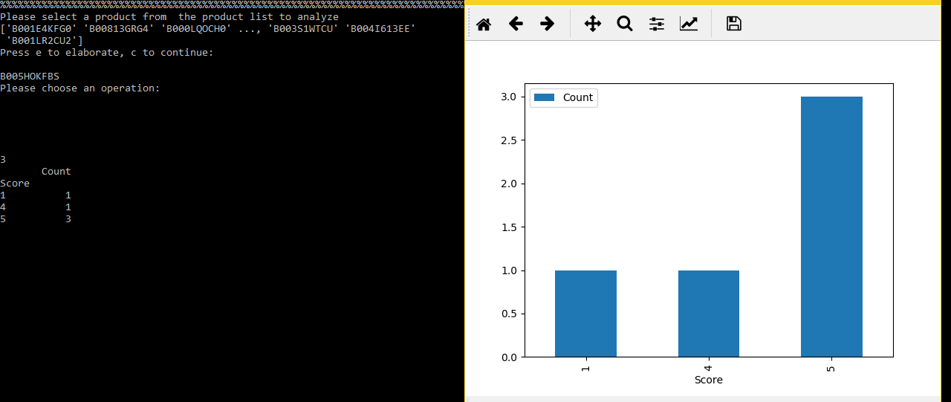
IMPLEMENTATION AND ANALYSIS

Slide 18
IMPLEMENTATION AND ANALYSIS
4. Providing the time series analysis for the product:
The time series analysis is provided for each product based on the previous years records.
This indicates how the product is seen by the people over time.

Slide 19
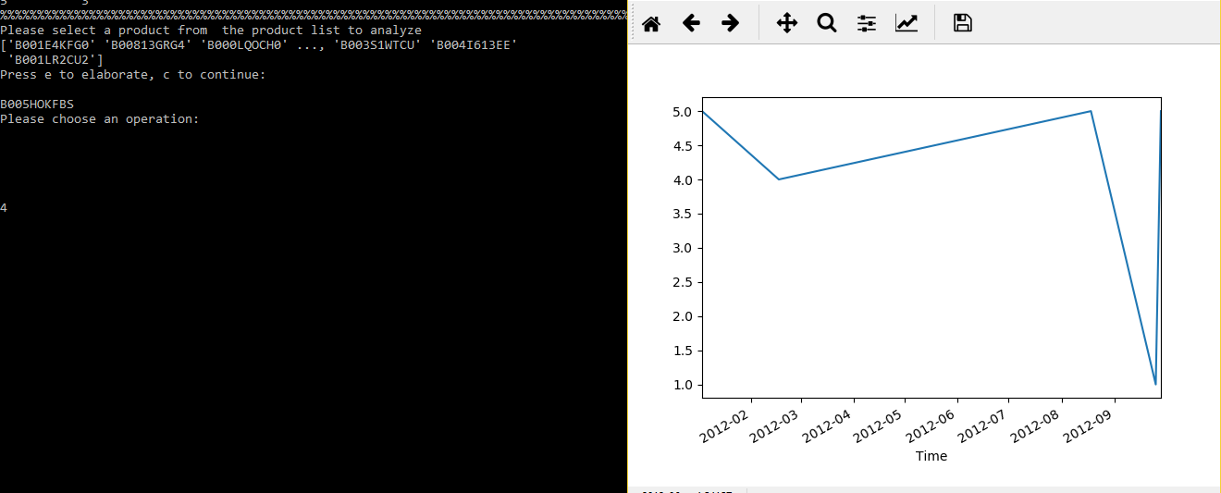
IMPLEMENTATION AND ANALYSIS

Slide 20
THANK YOU

